Slide 1
Chapter 12: Testability
Testing leads to failure, and failure leads to understanding.
—Burt Rutan

Slide 2
Chapter Outline
What is Testability?
Testability General Scenario
Tactics for Testability
Tactics-Based Questionnaire for Testability
Patterns for Testability
Summary

Slide 3
What is Testability?
Software testability refers to the ease with which software can be made to demonstrate its faults through (typically execution-based) testing.
Specifically, testability refers to the probability, assuming that the software has at least one fault, that it will fail on its next test execution.
Intuitively, a system is testable if it “reveals” its faults easily.

Slide 4
What is Testability?
For a system to be properly testable, it must be possible to control each component’s inputs (and possibly manipulate its internal state) and then to observe its outputs (and possibly its internal state, either after or on the way to computing the outputs).

Slide 5
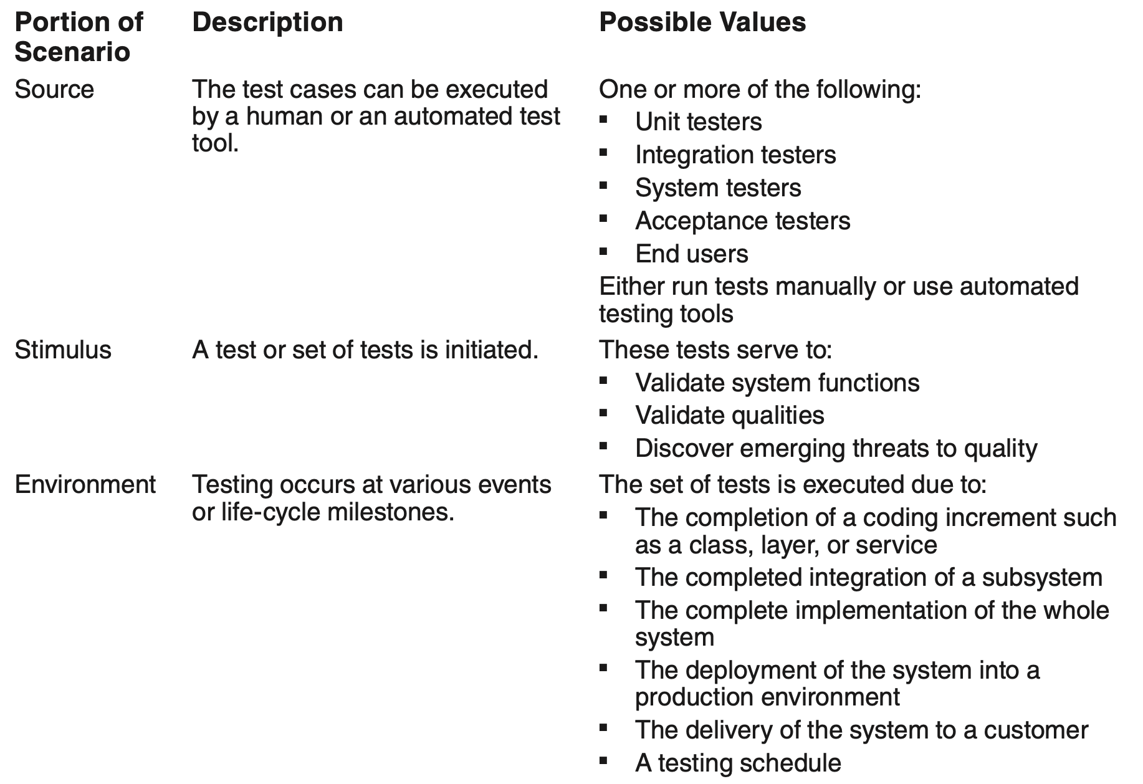
Testability General Scenario

Slide 6
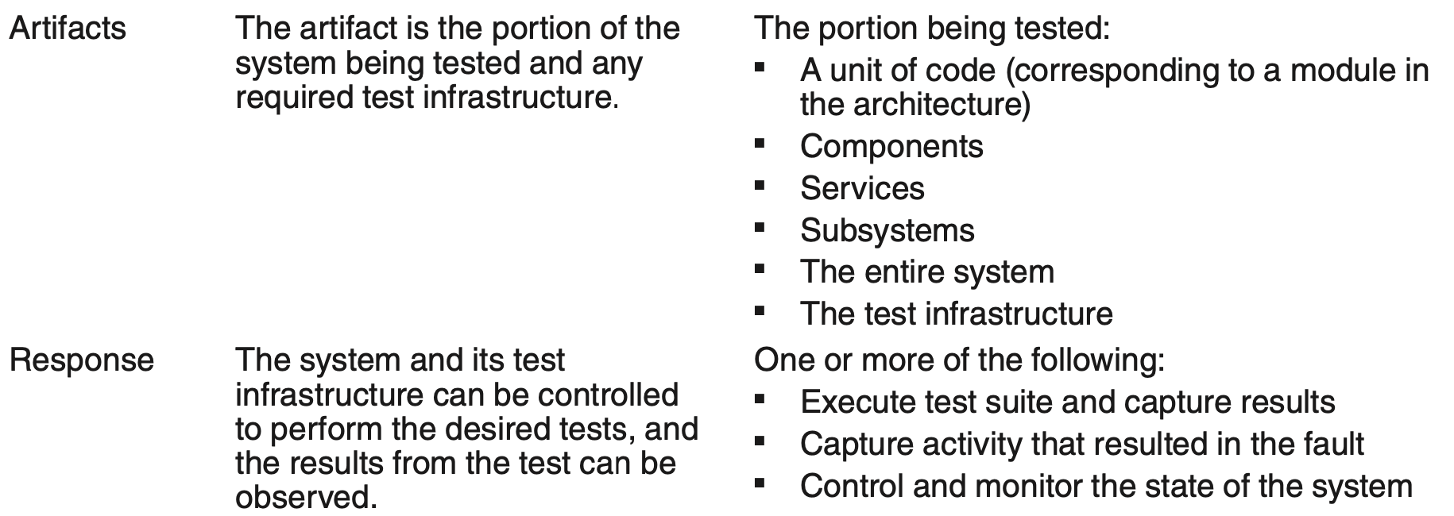
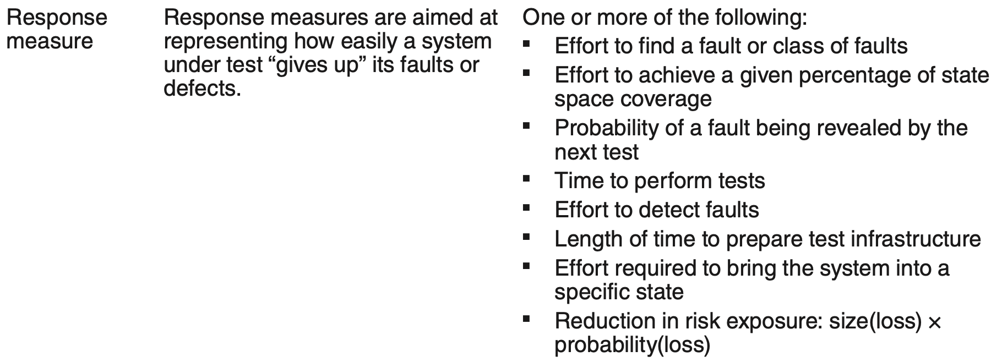
Testability General Scenario

Slide 7
Sample Concrete Testability Scenario
The developer completes a code unit during development and performs a test sequence whose results are captured and that gives 85 percent path coverage within 30 minutes.

Slide 8
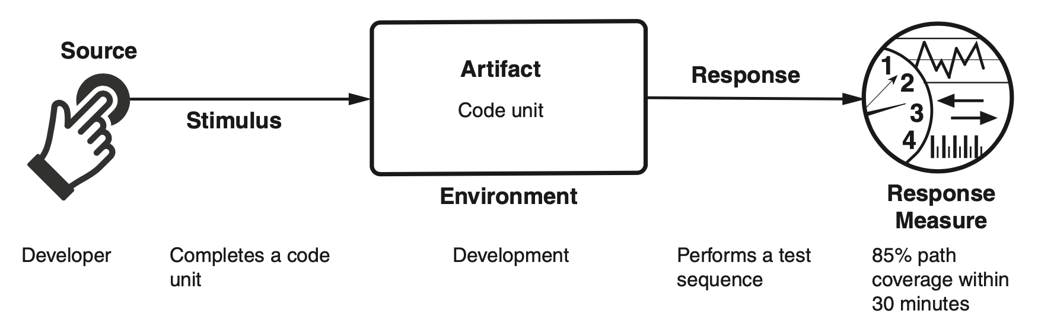
Sample Concrete Testability Scenario

Slide 9
Goal of Testability Tactics
Tactics for testability are intended to promote easier, more efficient, more capable testing.
There are two categories of tactics for testability:
The first category deals with adding controllability and observability to the system.
The second deals with limiting complexity in the system’s design.

Slide 10
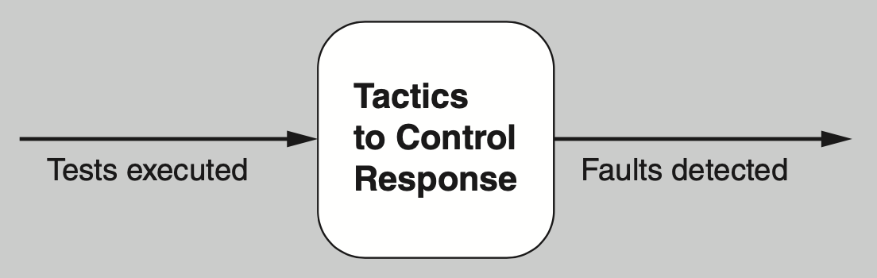
Goal of Testability Tactics

Slide 11
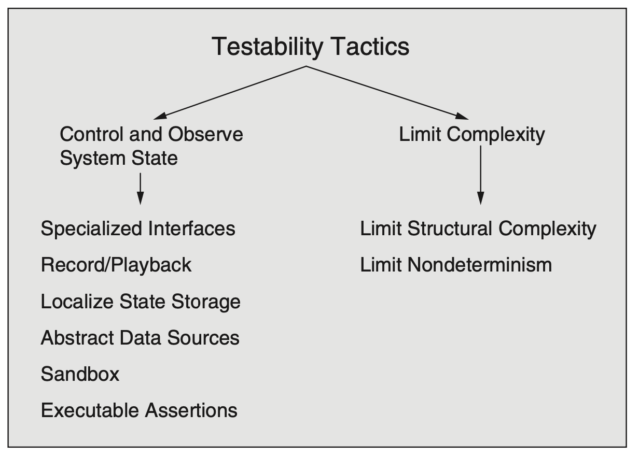
Testability Tactics

Slide 12
Control and Observe System State
Specialized interfaces. Having specialized testing interfaces allows you to control or capture variable values for a component through the application of a test harness or through normal execution.
Record/playback. The state that caused a fault is often difficult to re-create. Recording the state when it crosses an interface allows that state to be used to re-create the fault.
Localize state storage. To start a component in an arbitrary state for a test, it is convenient if state is stored in a single place. By contrast, if the state is buried or distributed, this approach becomes difficult. The state can be fine-grained, even bit-level, or coarse-grained to represent broad abstractions or overall operational modes.

Slide 13
Control and Observe System State
Abstract data sources. Similar to the case when controlling a program’s state, the ability to control its input data makes it easier to test. Abstracting the interfaces lets you substitute test data more easily.
Sandbox. “Sandboxing” refers to isolating an instance of the system from the real world to enable experimentation that is unconstrained by any worries about having to undo the consequences of the experiment. Testing is facilitated by the ability to operate the system in such a way that it has no permanent consequences, or so that any consequences can be rolled back.
Executable assertions. With this tactic, assertions are (usually) hand-coded and placed at desired locations to indicate when and where a program is in a faulty state. The assertions are often designed to check that data values satisfy specified constraints.

Slide 14
Limit Complexity
Limit structural complexity. This tactic includes avoiding or resolving cyclic dependencies between components, isolating and encapsulating dependencies on the external environment, and reducing dependencies between components.
Limit nondeterminism. The counterpart to limiting structural complexity is limiting behavioral complexity. This tactic involves finding all sources of nondeterminism, and weeding them out.

Slide 15
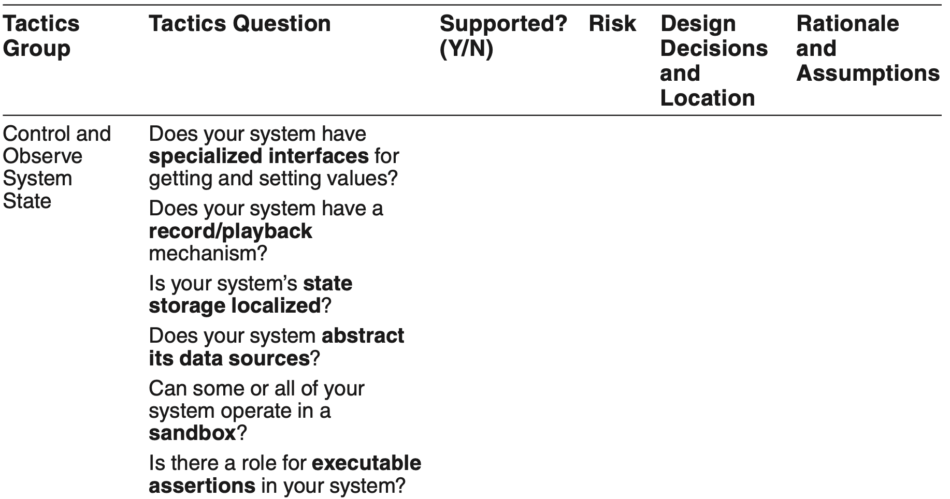
Tactics-Based Questionnaire for Testability

Slide 16
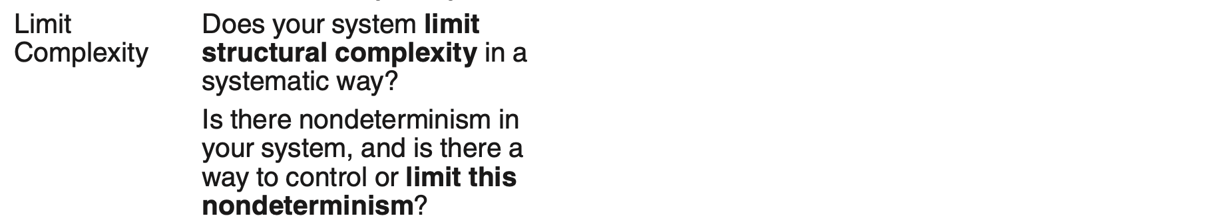
Tactics-Based Questionnaire for Testability

Slide 17
Dependency Injection Pattern for Testability
In the dependency injection pattern, a client’s dependencies are separated from its behavior.
This pattern makes use of inversion of control. Unlike in traditional declarative programming, where control and dependencies reside explicitly in the code, inversion of control dependencies means that control and dependencies are provided from, and injected into the code, by some external source.

Slide 18
Dependency Injection Pattern Benefits
Benefits:
Test instances can be injected, and these test instances can manage and monitor the state of the service.
Thus the client can be written with no knowledge of how it is to be tested.

Slide 19
Dependency Injection Pattern Tradeoffs
Tradeoffs:
Dependency injection makes runtime performance less predictable, because it might change the behavior being tested.
Adding this pattern adds a small amount of up-front complexity and may require retraining of developers to think in terms of inversion of control.

Slide 20
Strategy Pattern
In the strategy pattern, a class’s behavior can be changed at runtime.
This pattern is often employed when multiple algorithms can be employed to perform a given task, and the specific algorithm to be used can be chosen dynamically.
The class simply contains an abstract method for the desired functionality, with the concrete version of this method being selected based on contextual factors.

Slide 21
Strategy Pattern Benefits
This pattern makes classes simpler, by not combining multiple concerns (such as different algorithms for the same function) into a single class.

Slide 22
Strategy Pattern Tradeoffs
The strategy pattern, like all design patterns, adds a small amount of up-front complexity. If the class is simple or if there are few runtime choices, this added complexity is likely wasted.
For small classes, the strategy pattern can make code slightly less readable. However, as complexity grows, breaking up the class in this way can enhance readability.

Slide 23
Intercepting Filter Pattern
The intercepting filter pattern is used to inject pre- and post-processing to a request or a response between a client and a service.
Any number of filters can be defined and applied, in an arbitrary order, to the request before passing the request to the eventual service.

Slide 24
Intercepting Filter Pattern Benefits
This pattern, like the strategy pattern, makes classes simpler, by not placing all of the pre- and post-processing logic in the class.
Using an intercepting filter can be a strong motivator for reuse and can dramatically reduce the size of the code base.

Slide 25
Intercepting Filter Pattern Tradeoffs
If a large amount of data is being passed to the service, this pattern can be highly inefficient and can add a nontrivial amount of latency, as each filter makes a complete pass over the entire input.

Slide 26
Summary
Ensuring that a system is easily testable has payoffs both in terms of the cost of testing and the reliability of the system.
Controlling and observing the system state is a major class of testability tactics.
Complex systems are difficult to test because of their large state space, and because of the many interconnections among the elements. Consequently, limiting complexity is another class of tactics that supports testability.

